Slide 1

Setup & Management Raspberry pi
Lecturer: Reza Arjmandi
Summer 2016
Preface:
Introduction SBC, Raspberry pi, Setup and management

Slide 2
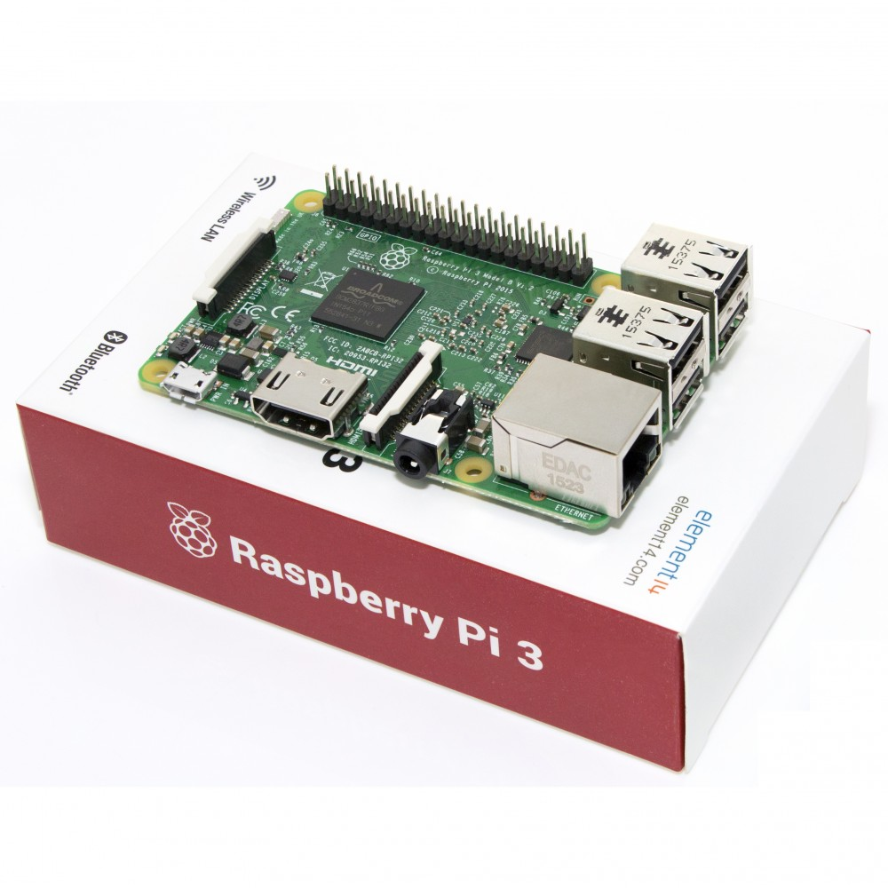
Introduction
the Raspberry Pi has found a role both as a very low-cost Linux based computer and as a platform for embedded computing
When you buy a Raspberry Pi, you are essentially buying an assembled printed circuit board. It does not even include a power supply or operating system.

Slide 3
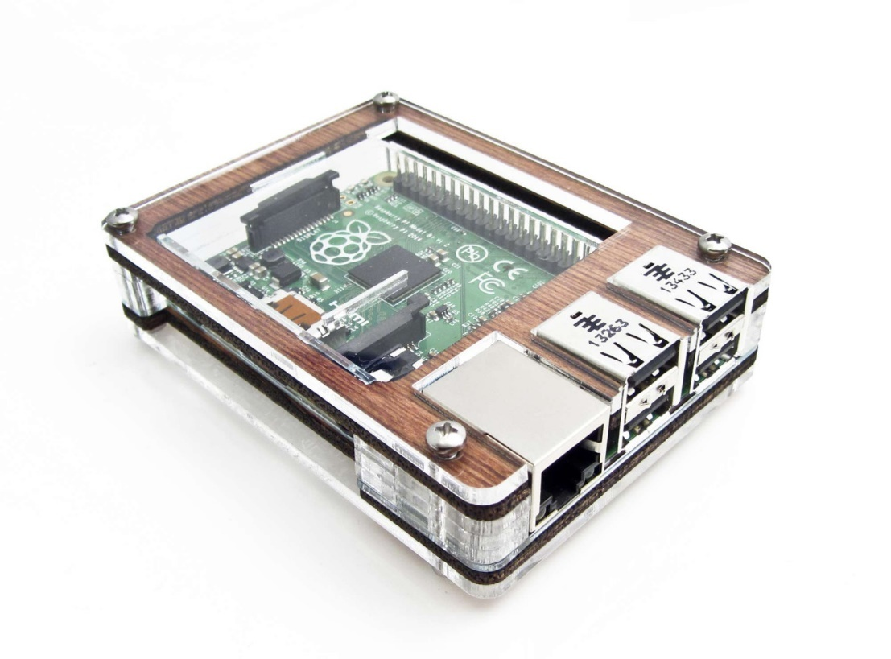
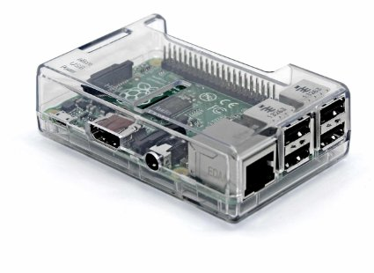
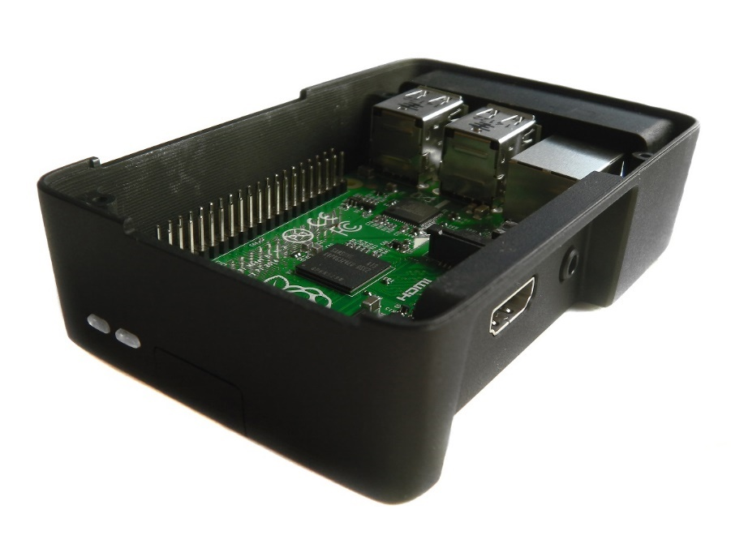
Enclosing a Raspberry Pi
You need an enclosure for your Raspberry Pi.
The Raspberry Pi does not come with an enclosure unless you buy one as part of a kit. This makes it a little vulnerable, as there are bare connections on the underside of the circuit board that could easily short if the Raspberry Pi is placed on something metal.

Slide 4
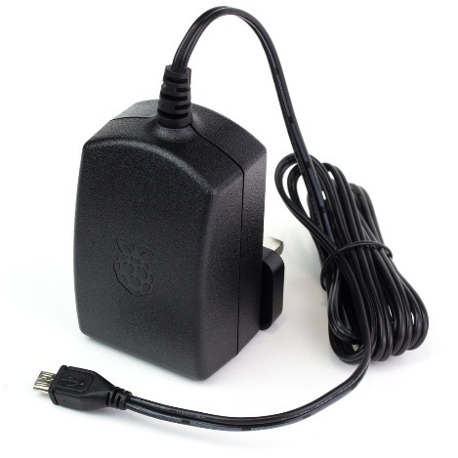
Selecting a power supply
You need to select a power supply for your Raspberry Pi.
The basic electrical specification for a power supply suitable for a Raspberry Pi is that it supplies a regulated 5V DC (direct current) and can supply a current of up to 1500mA. It must also have a micro USB plug on the end of the lead.
If you are going to be using another USB peripherals that use significant amounts of power, then I would get a power supply capable of 3.5A.
The power supply and connector are actually the same as those found in many smartphone chargers. If they are terminated in a micro USB plug, then they are almost certainly 5V . The only question, then, is if they can supply enough current. If they can’t, then a few bad things can happen:
• They may get hot and be a potential fire risk.
• They may just fail.
• At times of high load, the voltage may dip, and the Raspberry Pi may reset itself.

Slide 5
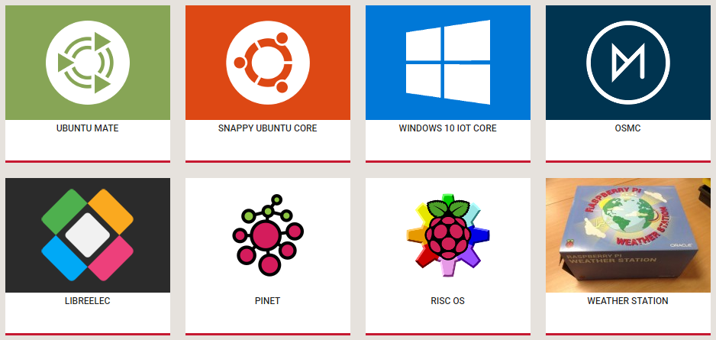
Selecting an Operating System Distribution
If you plan to build hardware projects with the Raspberry Pi, then use Raspbian . Of these, Raspbian is the official and most commonly used distribution for Raspberry Pi
If you plan to use your Raspberry Pi as a media center, there are a number of distributions specifically for that purpose .
In this course, we use the Raspbian distribution almost exclusively, although most of the recipes will work with any Debian-based distribution.

Slide 6
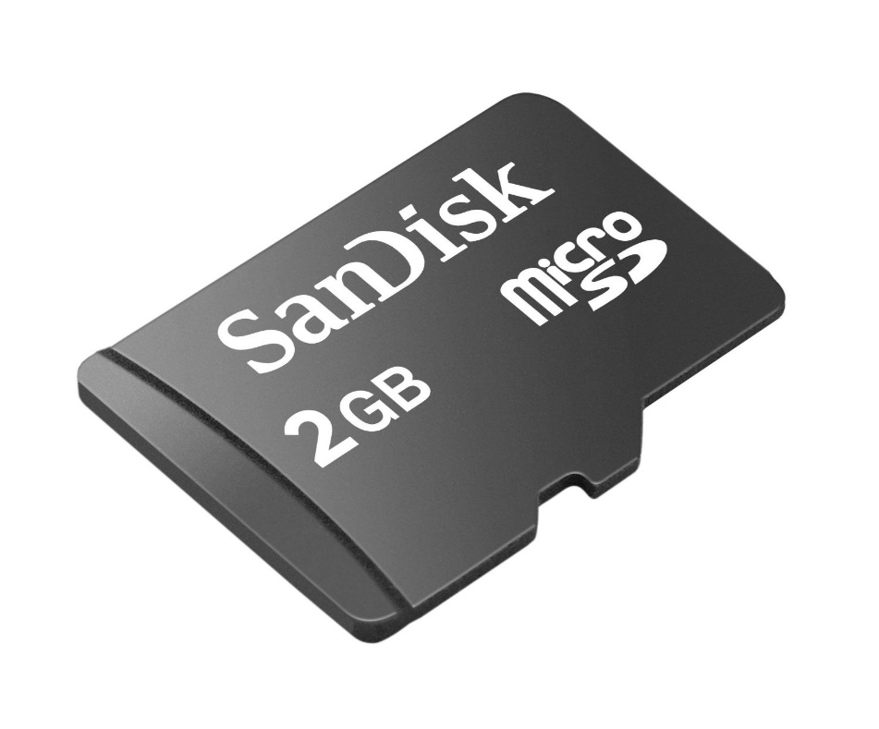
Install Operation System
For NOOBS to install correctly onto an SD crd, the card must be formatted as FAT
How to install Operation System?
1-Use ISO Image File and Image Writer Software
2-NOOBS (for raspbian)

Slide 7
Linux Interfaces
CLI (Command Line Interface)
GUI (Graphical User Interface)

Slide 8

Get course files and projects
For getting course project files, presentation and all practices with run command in terminal:
sudo git clone git@github.com:reza-arjmandi/rpi-course.git
Also you can use GitHub Desktop application from following link (suitable for windows os):
https://desktop.github.com/

Slide 9
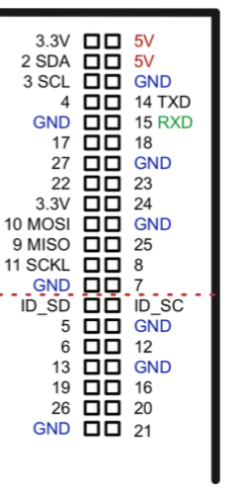
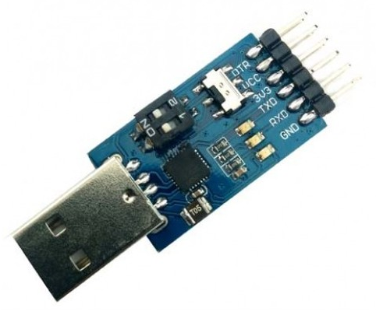
Connect with serial line

Slide 10
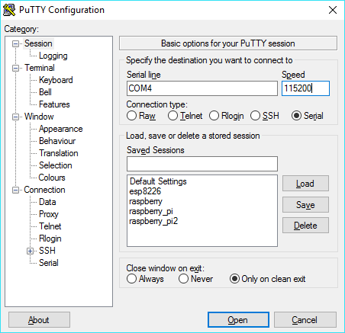
Connect with serial line
1) Append the following lines to the config.txt file which is located in the root of the card for enable uart:
enable_uart=1
2) Connect with putty.
3) change network settings:
sudo nano /etc/wpa_supplicant/wpa_supplicant.conf
And add the following lines to end of file:
network={
ssid="AndroidAP2"
psk="cfjr8062123"
key_mgmt=WPA-PSK
}

Slide 11
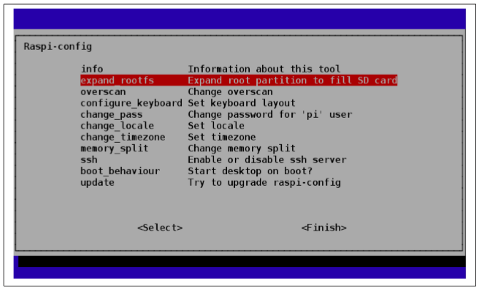
Using All the Storage on the SD Card
When an operating system is written to a Raspberry Pi’s SD card, the partition size is fixed by the image you install so you cannot use the whole of the SD card. This leaves little room for your own files.
To fix this, you need to run the raspi-config tool
You can start it any time you need to adjust the configuration by opening a Terminal session and issuing the command: $ sudo raspi-config
Scroll down to the option expand_rootfs, and then use the cursor keys to press the Select button (bellow Figure ). You will see a confirmation message, and then your Raspberry Pi will need to restart for the change to take effect. You should now be able to use the full capacity of the SD card.

Slide 12
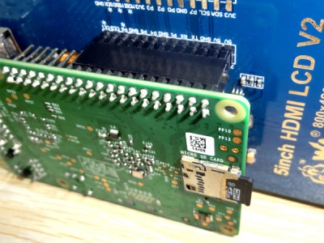

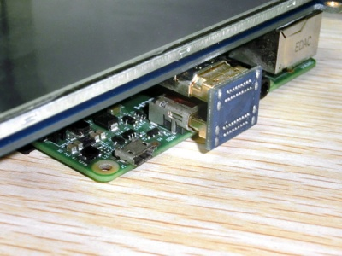
Install HDMI LCD
Driver installation:
1) Copy the LCD driver to the micro SD card (or copy the driver to the system of Pi using a USB drive).
2) Append the following lines to the config.txt file which is located in the root of the card:
3) The LCD will display after booting up. Then open a terminal to install the touch driver which can be found in the /boot/ directory.

Slide 13


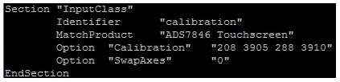
Install HDMI LCD
Touch screen calibration:
This LCD can be calibrated using a program called xinput_calibrator which can be downloaded from Xinput-calibrator_0.7.5-1_armhf
Extract and copy the software Xinput-calibrator_0.7.5-1_armhf.deb to the Raspbian of your Pi.
Install it with the commands:
Click the "Menu" button on the task bar, choose "Preference" -> "Calibrate Touchscreen".
Finish the touch calibration following the prompts. Maybe rebooting is required to make calibration active.
You can create a 99-calibration.conf file to save the touch parameters (not necessary if file exists).
Save the touch parameters (may differ depending on LCD) to 99-calibration.conf, as shown in the picture:

Slide 14
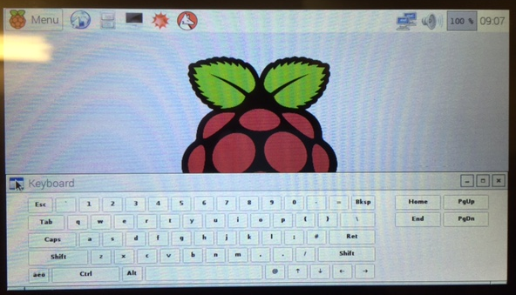
Install Virtual Keyboard
First thing to do:
Open terminal
Second you will need to update the repositories:
sudo apt-get update
An upgrade to the whole system isn't needed but it is recommended:
sudo apt-get upgrade
Now we can install the virtual keyboard:
sudo apt-get install matchbox-keyboard
Rebooting is recommended:
sudo reboot
Now you can access the keyboard:
MENU >> ACCESSORIES >> KEYBOARD

Slide 15
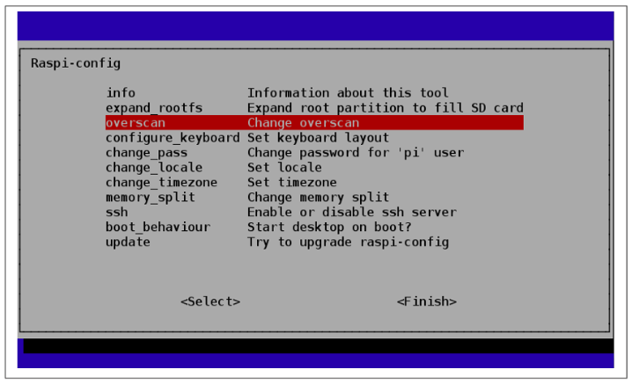
Adjusting the picture size on your monitor
When you first connect a Raspberry Pi to a monitor, you may find that some of the text cannot be read because it extends off the screen, or the picture isn’t using all the space available on the screen.
If your text extends off the screen, use the raspi-config tool to turn overscan off. To do this, run raspi-config by opening a Terminal session and issuing the command:$ sudo raspi-config
Then use the cursor keys to scroll down to the option overscan, and turn overscan off

Slide 16
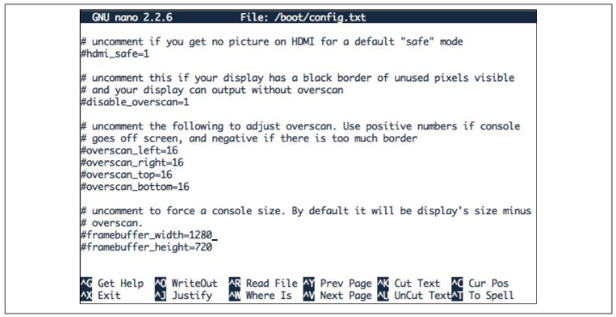
Adjusting the picture size on your monitor
If your problem is that there is a large black border around the picture, then you can reduce this (and possibly eliminate it entirely) by editing the file /boot/config.txt using the command:
$ sudo nano /boot/config.txt
Look for the section dealing with overscan. The four lines you need to change are shown in the middle of following Figure.
For the lines to take effect, you first need to uncomment them by removing the # character from the start of each line. Then, using trial and error, change the settings until the screen fills as much of the monitor as possible. Note that the four numbers should be negative. Try setting them all to –20 to start with.

Slide 17
Maximizing Performance
Your Raspberry Pi seems to be very slow, so you want to overclock it to make it run faster.
You can increase the clock frequency of a Raspberry Pi to make it run a little faster. This will make it use a bit more power and run a little hotter (see the Discussion next).
The method of overclocking described here is called dynamic overclocking because it automatically monitors the temperature of the Raspberry Pi and drops the clock speed back down if things start to get too hot.
To make your Pi overclock, run the raspi_config utility by issuing the following command in a Terminal:
$ sudo raspi-config
Select the overclock option in the menu, and you are presented with the options in following Figure.
Select an option. If you find that your Raspberry Pi starts to become unstable and hangs unexpectedly, then you may need to choose a more conservative option or turn overclocking off by setting it back to None.

Slide 18
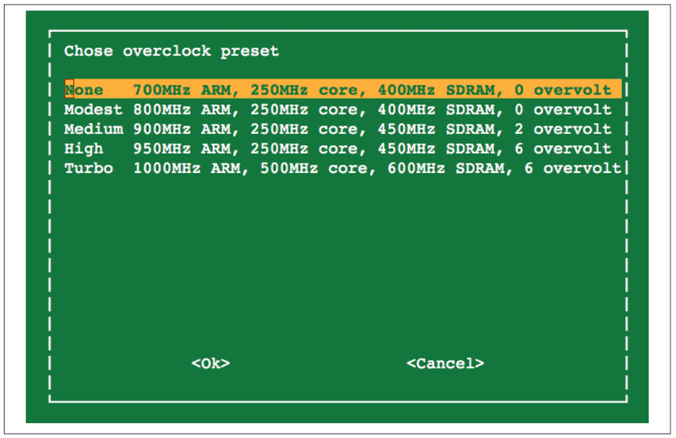
Maximizing Performance

Slide 19
Changing Your Password
By default, the password for a Raspberry Pi will be raspberry. You want to change this.
You can use the raspi-config tool to change your password. Run the raspi_config utility by issuing the following command in a Terminal : $ sudo raspi-config
Then select the change_pass option in the menu and follow the prompts shown in following Figure.
You can also change the password from a Terminal session simply by using the passwd command as follows:
$ sudo passwd
Changing password for pi.
(current) UNIX password:
Enter new UNIX password:
Retype new UNIX password:
passwd: password updated successfully

Slide 20
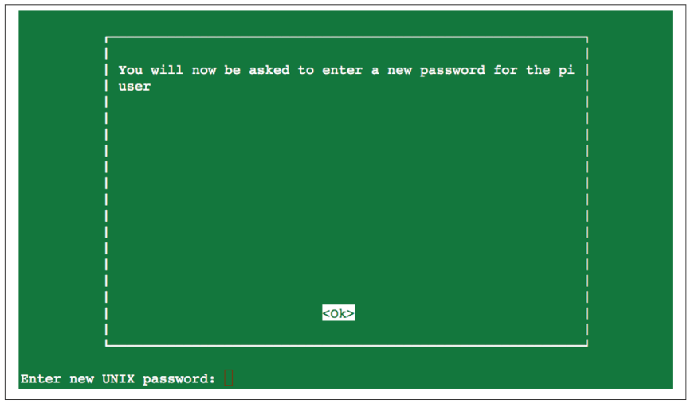
Changing Your Password

Slide 21
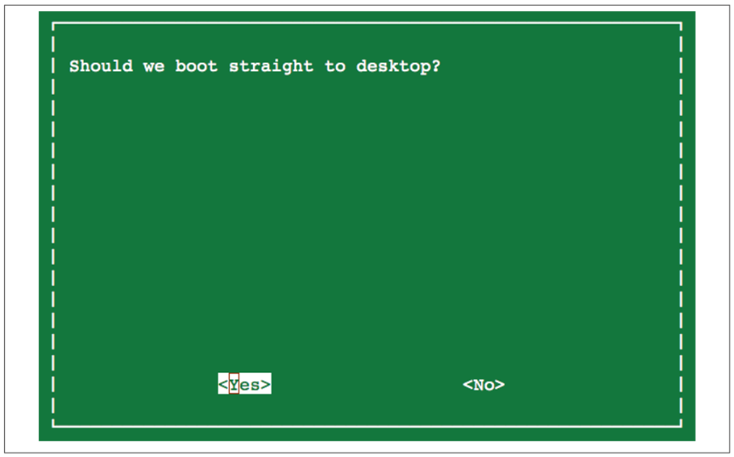
Setting the Pi to Boot Straight into a Windowing System
Every time you reboot your Raspberry Pi, you have to log in and then start the desktop manually. You want to make this automatic.
You can use the raspi-config tool to change the boot behavior so that the Raspberry Pi automatically logs you in and starts the desktop. Run the raspi_config utility by issuing the following command in a Terminal: $ sudo raspi-config
Then select the boot_behaviour option in the menu and follow the prompts shown in following Figure.

Slide 22
Shutting Down Your Raspberry Pi
You want to shut down your Raspberry Pi.
1-Click on the red Logout button in the bottom-right corner of the desktop
2-You can also reboot from the command line by issuing the command:
sudo halt
Unlike shutting down most computers, shutting down a Rasperry Pi does not actually turn off the power. It goes into a low-power mode—and it is a pretty low-power device anyway (but the Raspberry Pi hardware has no control over its power supply).
You can buy a module that will turn off the power when the Raspberry Pi shuts down here: http://www.pi-supply.com/.

Slide 23


Contact us
www.e-system.ir
Info@e-system.ir

